Slide 1
IMPACT OF CORONA ON SDG
Presented by Datax Team:
EL YOUSSOUFI Aya BOUHADIOUI Asmae
EL MOTAKI Yassir ELASRI Mohamed Youssef

Slide 2


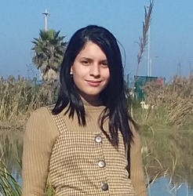


Meet Our Teams
MOHAMED YOUSSEF ELASRI
AYA EL YOUSSOUFI
YASSIR EL MOTAKI
ASMAE BOUHADIOUI
Second-year engineering student in data science and artificial intelligence at ENSAM RABAT
Second-year engineering student in data science and artificial intelligence at ENSAM RABAT
Second-year engineering student in data science and artificial intelligence at ENSAM RABAT
Second-year engineering student in data science and artificial intelligence at ENSAM RABAT
datascienceteamcomp@gmail.com

Slide 3
PLAN
PROBLEM DEFINITION
DATA VISUALIZATION
DATA CLEANING
EXPLORATORY DATA ANALYSIS
MACHINE LEARNING
CONCLUSION

Slide 4









PROJECT PIPELINE
01
02
03
04
05
DATA REPORTING
DATA CLEANING
EDA
MACHINE LEARNING
OPTIMISATION

Slide 5
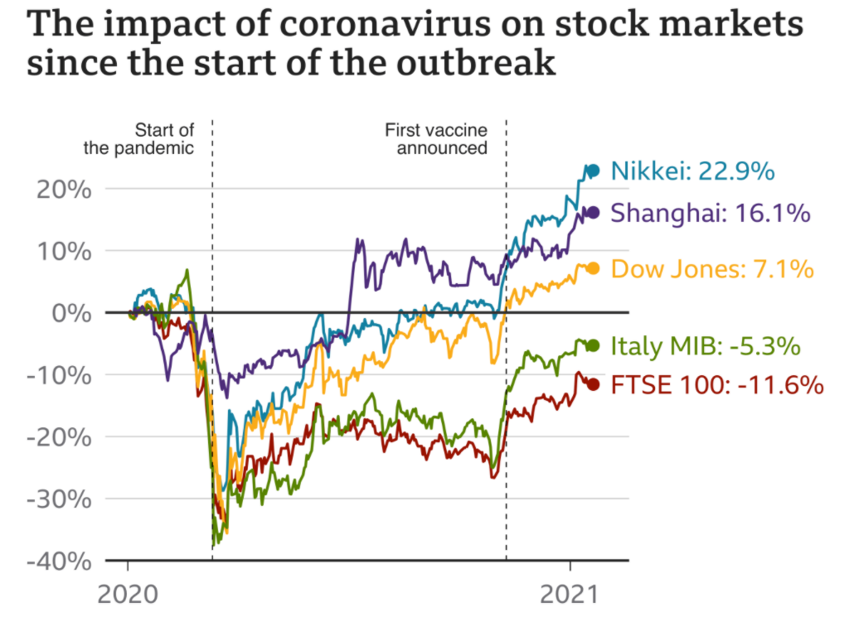
PROBLEM DEFINITION
Our project goal:
Analyze the different information on the impact of coronavirus on the economy and predict its values in each country by month or year
The coronavirus pandemic has reached almost every country in the world.
Big shifts in stock markets, where shares in companies are bought and sold, can affect the value of pensions or individual savings account
A difficult year for job seekers
Many people have lost their jobs or seen their incomes cut.
Unemployment rates have increased across major economies.

Slide 6
First look on our datasets
DATA CLEANING
Datasets:
Annual youth unemployment rate by the ILO (2009-2020)
Annual unemployment rate by the ILO (in 2021)
Annual proportion of children engaged in economic activity by the ILO.
COVID-19 finance sector related policy responses by the World Bank
COVID-19 national public responses in European countries by ECDC (2020-2021)
Annual work hours lost due to the COVID-19 pandemic by the ILO (2020-2021)
Annual proportion of women in managerial positions by ILO (2009 - 2020)
QUESTION TO ASK
How many people in each age group suffer from unemployment and how has been the impact of the coronavirus on the unemployment rate compared to each country?
How has been the impact of the coronavirus on young people and what is the percentage of this rate after the corona crisis compared to women and men?
Whether the rate of child labor in relation to each age interval was high or decreased after the crisis?
What percentage of women in leadership positions before and after the crisis?
What are the different financial measures that each country has taken against the crisis?
What are the predictions of this information in the following years?

Slide 7
DATA VISUALIZATION
DATA REPORTING

Slide 8
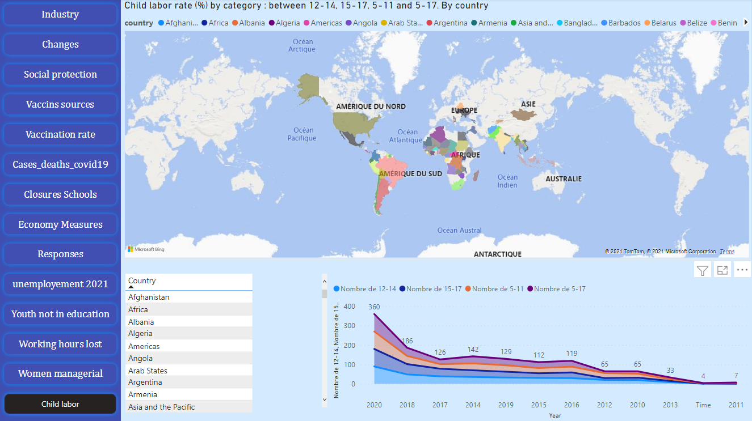

Slide 9
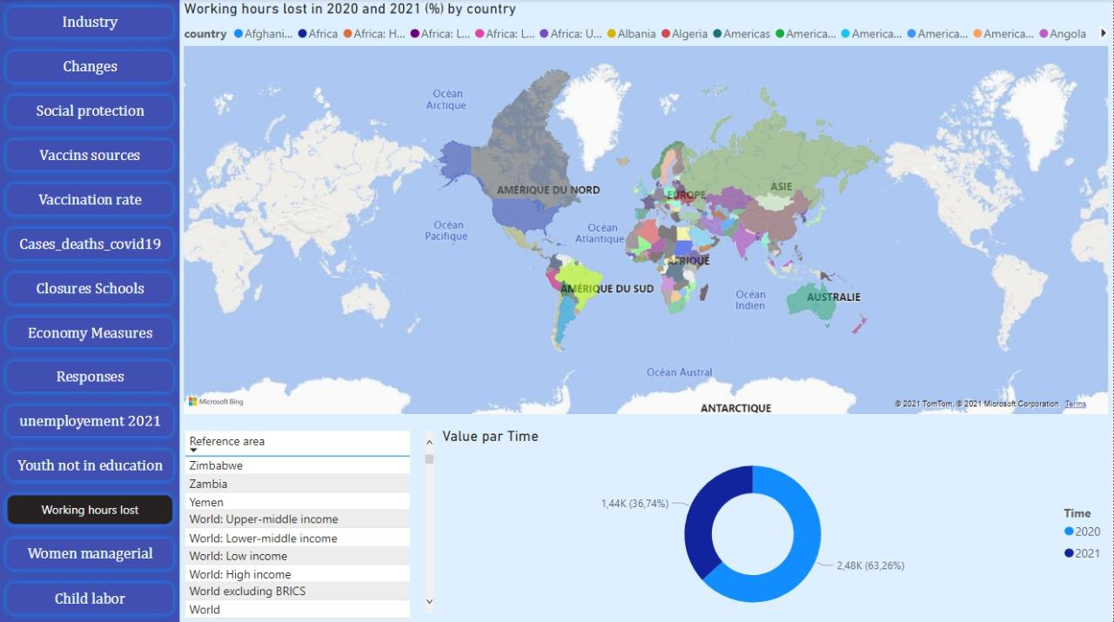

Slide 10
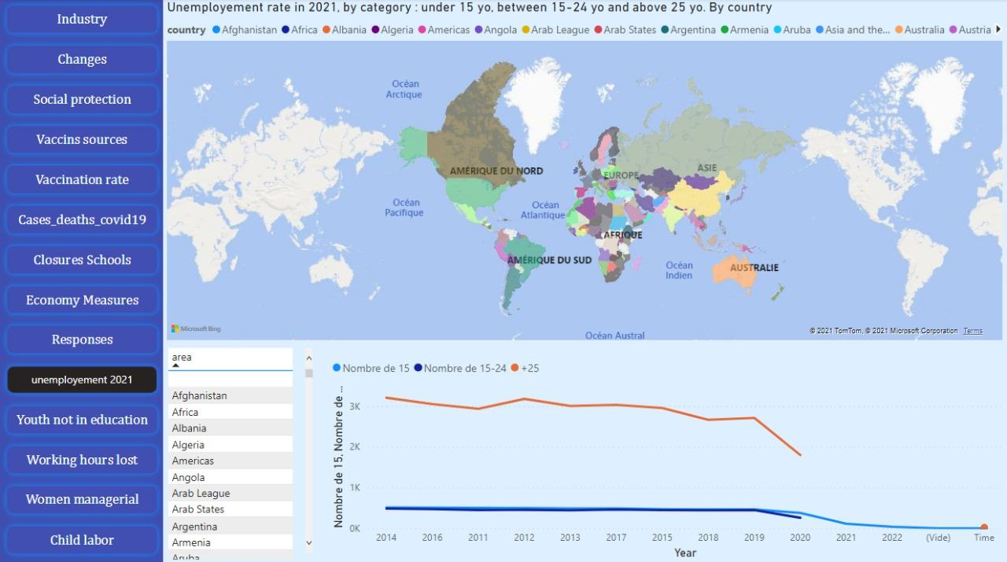

Slide 11
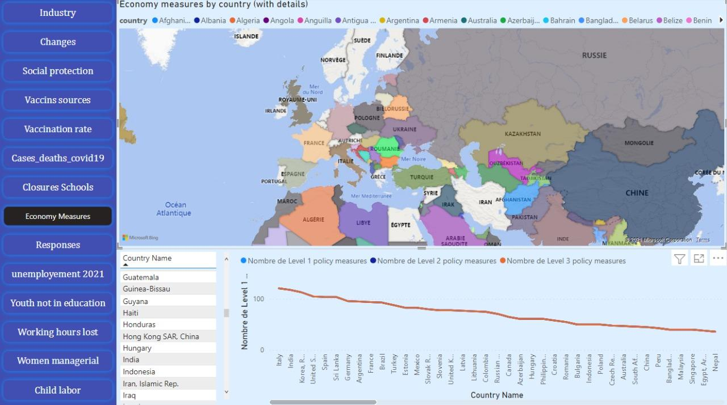

Slide 12
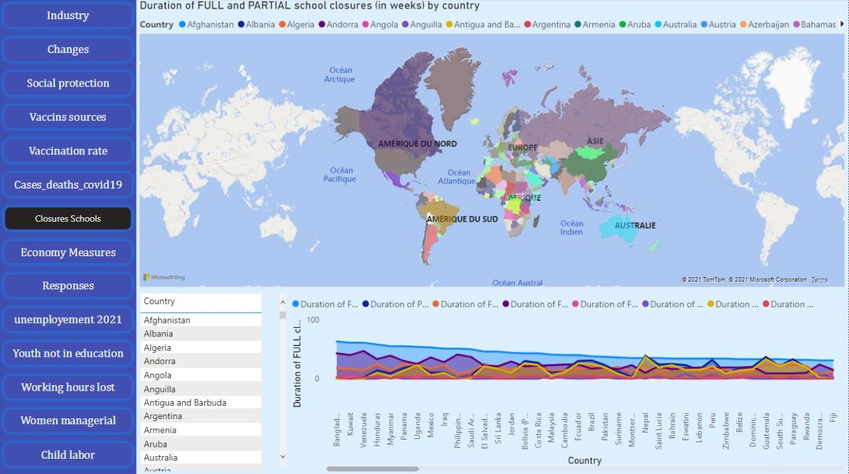

Slide 13
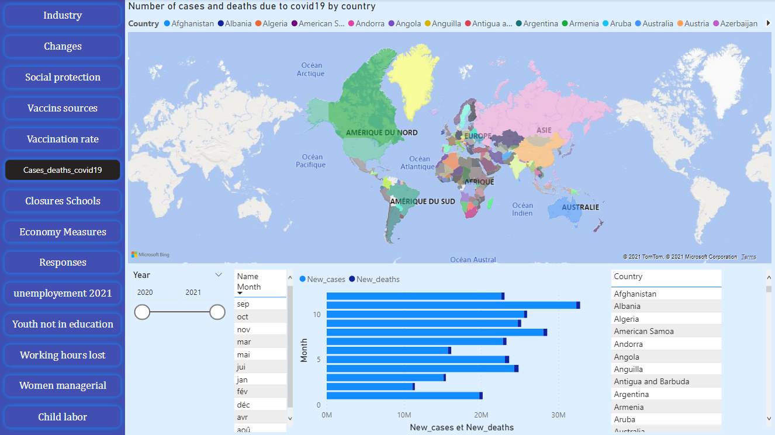

Slide 14
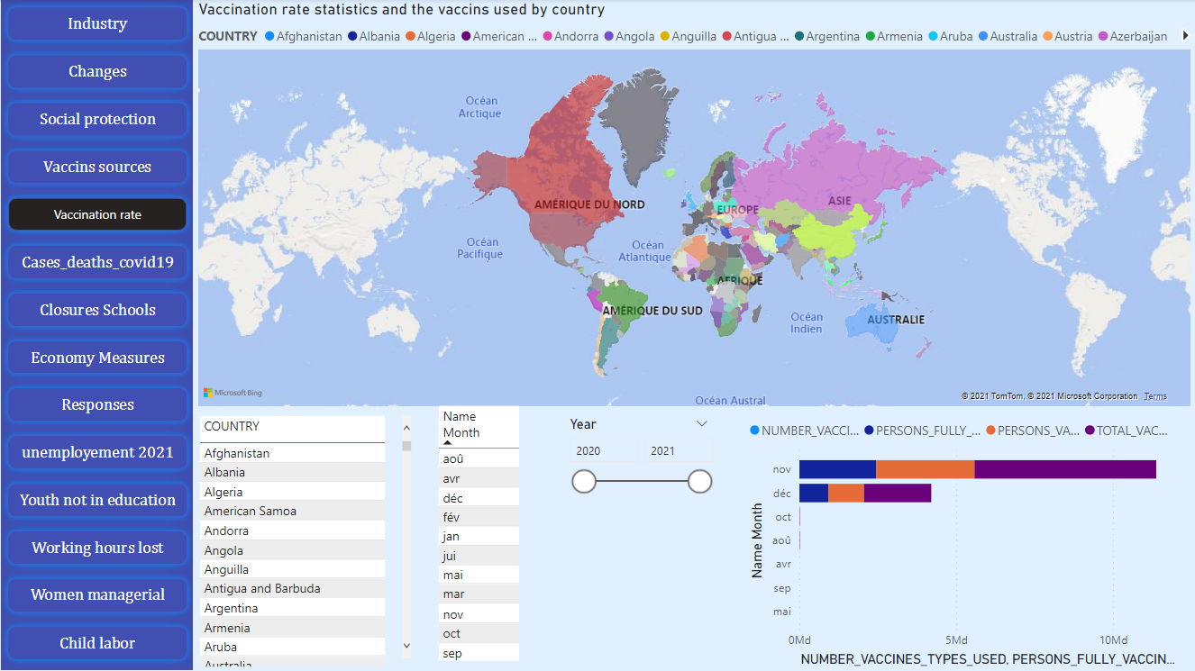

Slide 15
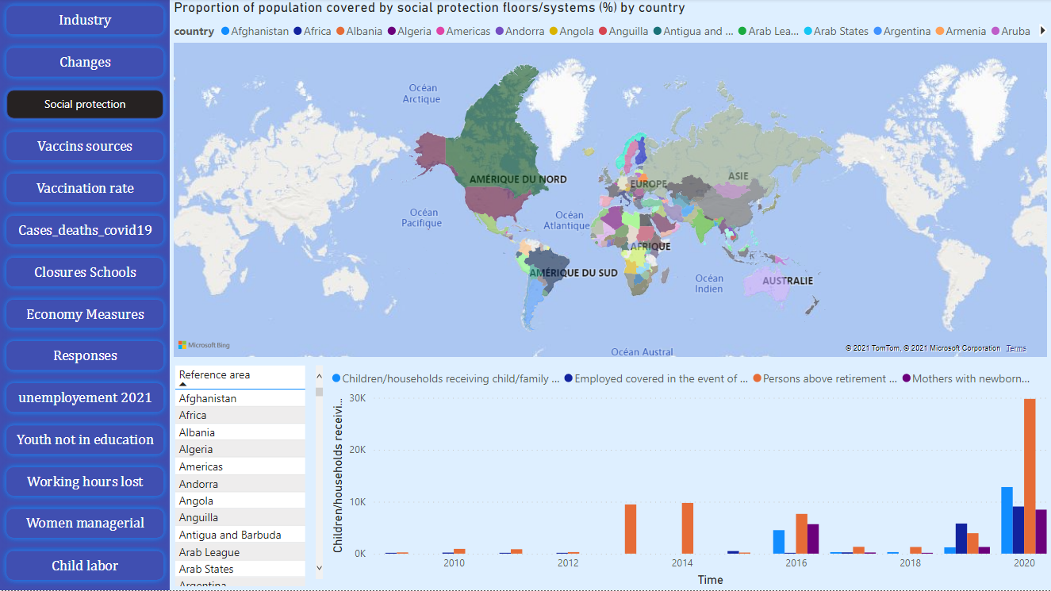

Slide 16
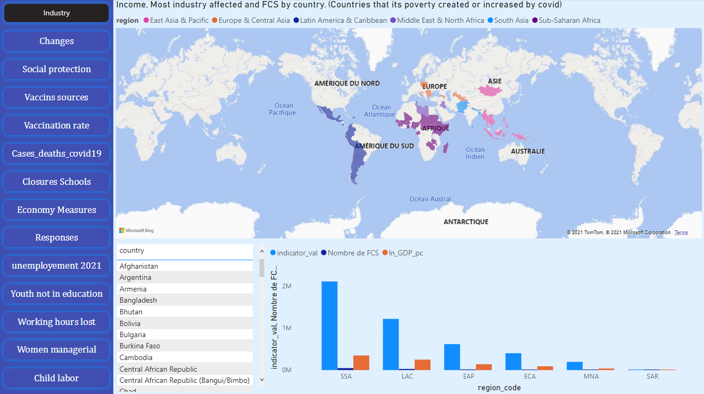

Slide 17
DATA CLEANING
PROJECT PIPELINE

Slide 18
DATA CLEANING
Dropping unnecessary columns in the Data frame using the correlation between columns
Skipping unnecessary rows in a CSV or XSLX file
Check the missing data in each column and replace them either with:
Most frequent value
Median
Mean
DATA CLEANING
Check if there is unnecessary Data — Repetitive Data, Duplicates and more
Check the outliers
Divide the data frame into two df, the first one contains categorical data and one of the numeric data in order to encode the categorical data using label Encoder

Slide 19
EXPLORATORY DATA ANALYSIS
PROJECT PIPELINE

Slide 20
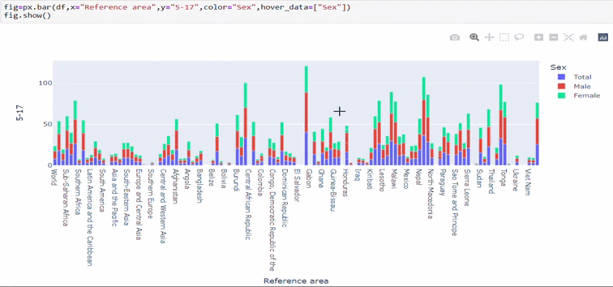
EXPLORATORY DATA ANALYSIS
Make a graph on each continent or country about the child labor,it is found that male children work more than females and even in the period of crisis

Slide 21
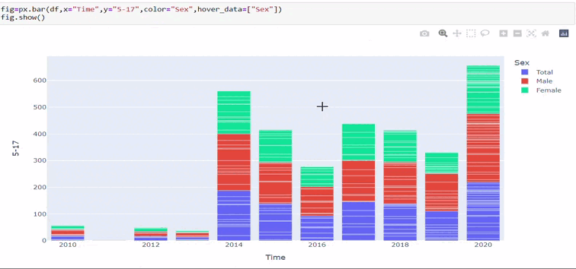
EXPLORATORY DATA ANALYSIS
The impact of the coronavirus especially in the year 2020 which has seen an increase in the child labor

Slide 22
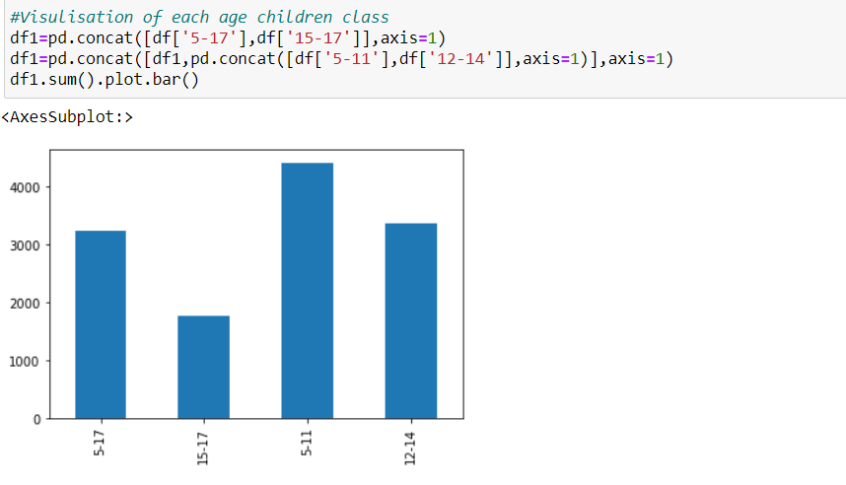
EXPLORATORY DATA ANALYSIS
the percentage of working children between 5-11 are high compared to others in the world

Slide 23
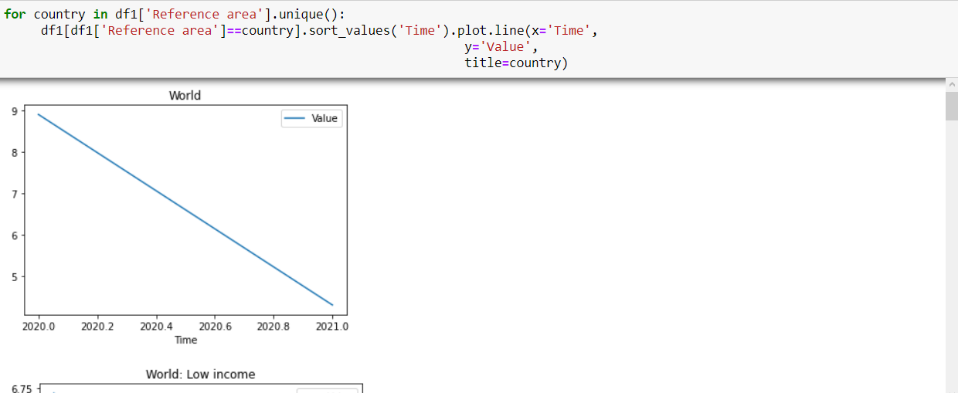
EXPLORATORY DATA ANALYSIS
Visualization of working hours lost in covid 19 and how the world's income has declined during the crisis

Slide 24
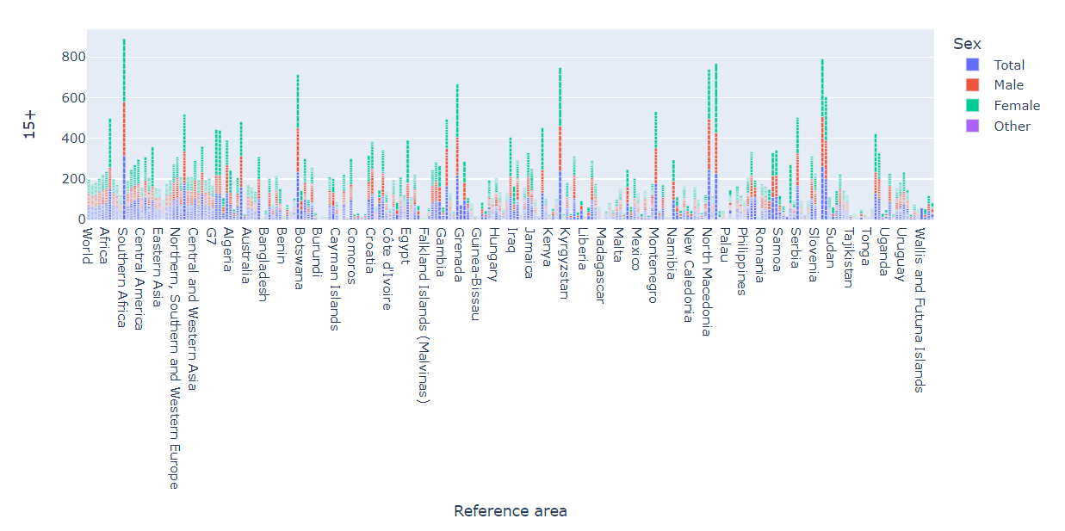
EXPLORATORY DATA ANALYSIS

Slide 25
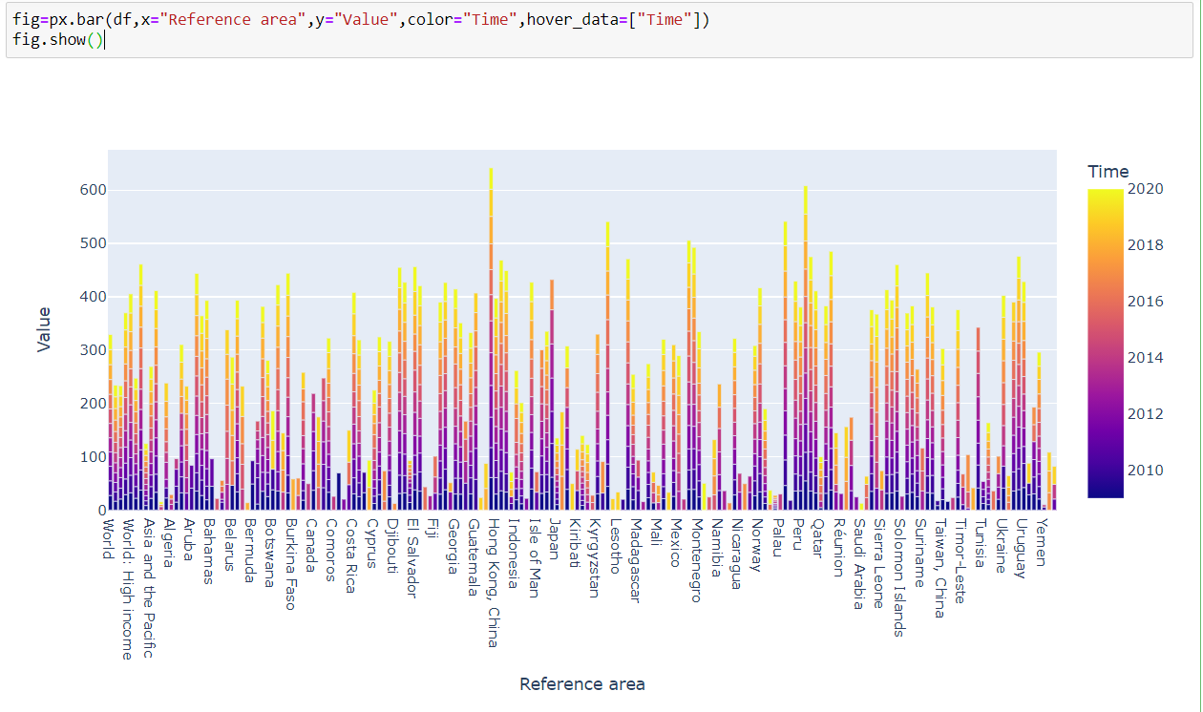
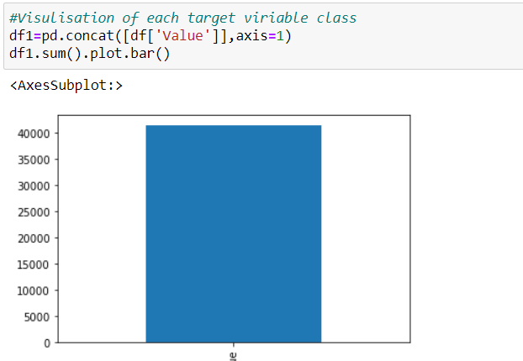
EXPLORATORY DATA ANALYSIS

Slide 26
CONCLUSION
PROJECT PIPELINE

Slide 27
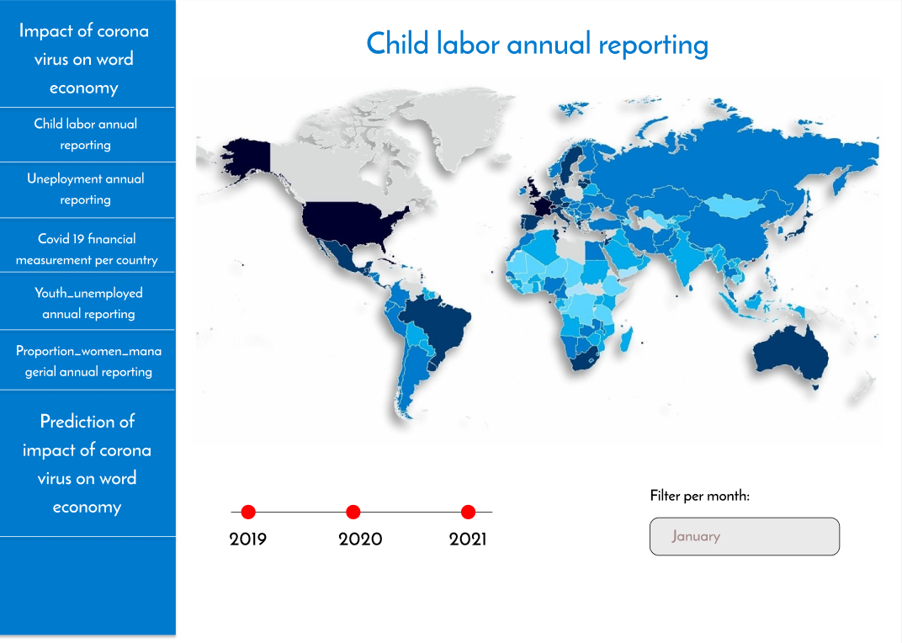

Slide 28
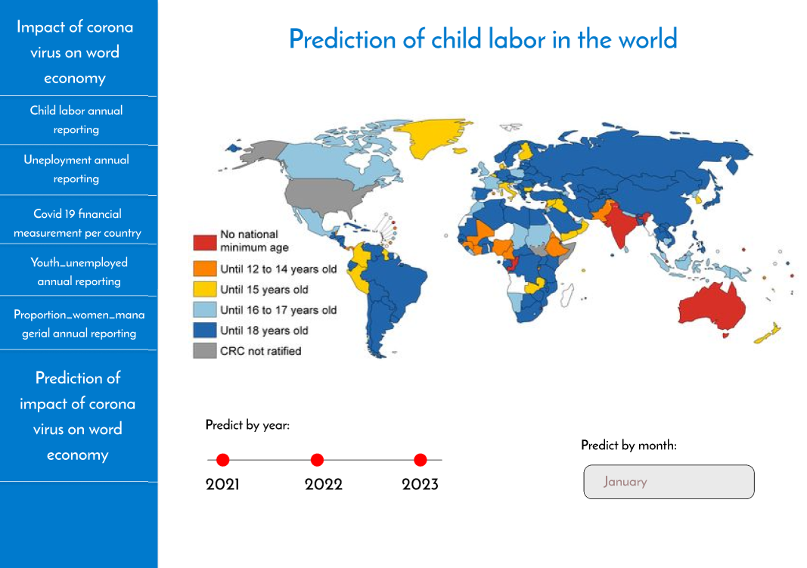

Slide 30
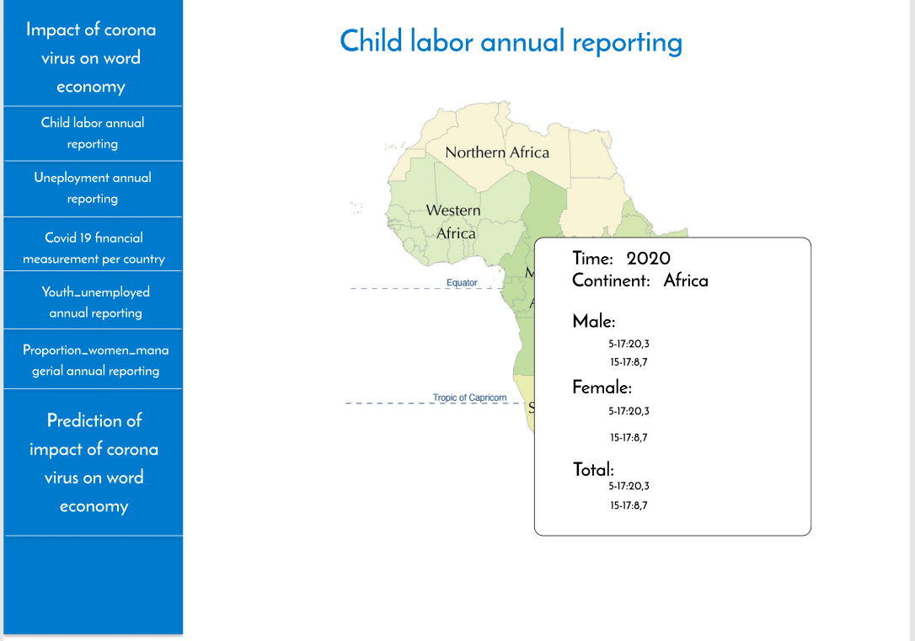

Slide 31
THANK YOU

